Slide 2

Acute HIV infection among individuals who start PrEP: ImPrEP, a demonstration project in the context of combination prevention in Brazil, Mexico and Peru
Juan V Guanira, MD, MPH
@jguanira
Share your thoughts on this presentation with #IAS2019
Notes:
Good mornig I want to thanks the organizers of this meeting for the oportunity to share some of the findings from ImPrEP study. I Will talk about Acute HIV infection among individuals who start PrEP

Slide 3
Background
PrEP is an effective HIV prevention tool, recommended as part of combination prevention for individuals at high risk for HIV acquisition.
Before initiating PrEP, an ongoing HIV infection must be ruled out, thereby preventing resistance and assuring adequate care.
During early acute HIV infection (AHI), neither HIV antibodies nor antigens can be detected by serologic tests, but virus could be detectable with molecular methods.
As molecular methods are not included in conventional PrEP screening, some individuals with AHI may be enrolled in PrEP,
Notes:
As all of us know, PrEP is an effective HIV prevention tool, recommended as part of combination prevention for individuals at high risk for HIV acquisition.
Also has been pointed out in all guidelines that before initiating PrEP, an ongoing HIV infection must be ruled out, thereby preventing resistance and assuring adequate care.
We also know that During early acute HIV infection (AHI), neither HIV antibodies nor antigens can be detected by serologic tests, but virus could be detectable with molecular methods.
Conventional PrEP screening do not include molecular methods for HIV detection, thereby some persons could be enrolled in PreP in early IV infection.

Slide 4
Background (2)
PrEP is being rolled-out in many countries around the globe
In Latin America, PrEP roll-out has been somewhat slow, Brazil being one of the few countries with a PrEP public health policy, and availability at health services
ImPrEP is a PrEP demonstration study to assess feasibility of daily oral PrEP provided to MSM and transgender people at risk for HIV in Brazil, Mexico and Peru.
ImPrEP uses a strategy of same-day PrEP initiation.
Notes:
Prep roll-out is ocurring aroun de world
In Latin America, PrEP roll-out has been somewhat slow, Brazil being one of the few countries with a PrEP public health policy, and availability at health services
ImPrEP is a PrEP demonstration study to assess feasibility of daily oral PrEP provided to MSM and transgender people at risk for HIV in Brazil, Mexico and Peru.
ImPrEP uses a strategy of same-day PrEP initiation.

Slide 5
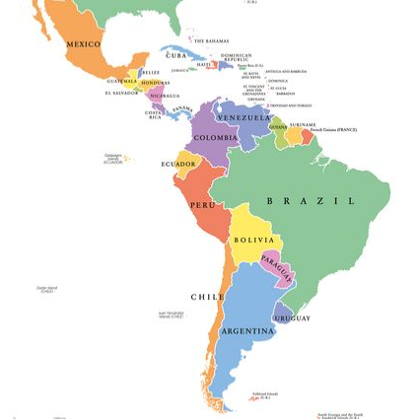
Background (3)
Mexico:
8 sites in 5 cities
3000 participants
Brazil:
14 sites in 10 cities
3000 participants
Peru:
10 sites in 6 cities
1500 participants
Enrollment started in January 2018, and will finish in October 2019
Notes:
Here we show the number f site per site and the total Amunt of participant assinged to each country.
Mexico contribute with 3000 participants at 8 sites in 5 cities, Brazil contribute with another 3000 participants at 14 sites in 10 cities and finaly, peru contribute with 1500 participants at 10 sites in 6 cities.
Enrolent started on january 2019 at brazil, we expecto to finish the enrolemnt by october 2019

Slide 6
Methods
AHI cases definition: Those enrolled with a negative HIV rapid test (4th generation in Mexico and Peru, 3rd generation in Brazil) with detectable virus using molecular methods.
Notes:
For this study an acute HIV infection case was defined as a person enrolled in the ImPrEP study with a negative HIV rapid test with detectable virus using molecular methods.
For Mexico and Peru 4th generation HIV rapid test were used, meanwhile a 3rd generation HIV rapid test were usedin Brazil

Slide 7
Methods
At enrollment, all participants self-reported information related to:
  Potential factors for HIV acquisition (# sex partners, condomless anal sex, STIs, etc),
  Use of post-exposure prophylaxis (PEP) in last 12 mo.
  Signs/symptoms suggestive of AHI in last 30 days.
Participants receive a 30-day supply of PrEP at first visit, after a negative HIV rapid test and no other exclusion criteria, to assure the minimal exposure to PrEP among individuals with AHI.
Notes:
At enrolment, all participants self-reported information related to:
Potencial factos associated to HIV acquisition, as number of sexual partners, condomless anal sex, seroestatus of sexual partner, among sti in the las 6 months others. Also usage of post exposure prophilaxis in the last 12 months, and sighns or symptoms suggestive of accute HIV infection.
Participants received 30 days pupply of prep at the first visit, after a negative HIV rapid test and no other exclusión criterio, to assure the minimal exposure to PrEP among individuals with acute HIV infection.

Slide 8
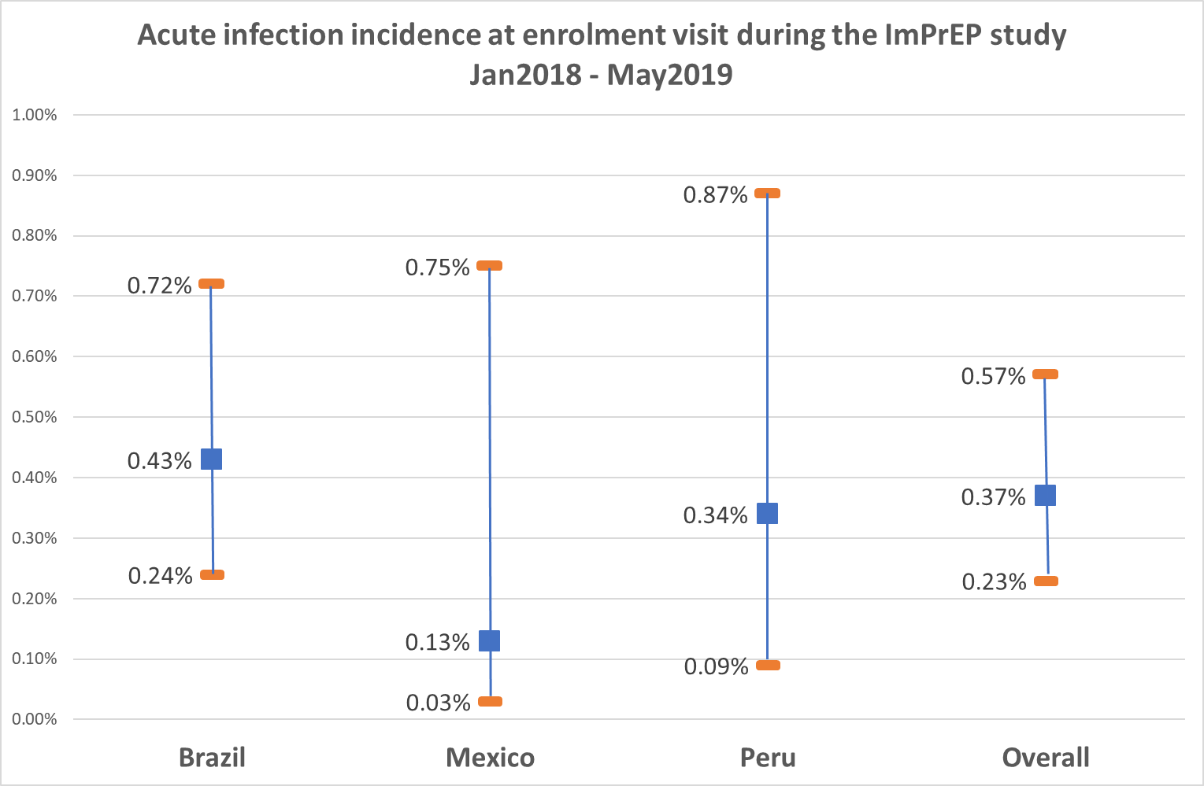
Results (1)
From January 2018 – May 2019, 5375 individuals were enrolled, 3452 in Brazil, 743 in Mexico and 1180 in Peru.
20 individuals with AHI were identified (15 in brazil, 1 in Mexico and 4 in Peru)
Point estimate
95% CI
AHI cases | 15 | 1 | 4 | 20
Total enrroled | 3452 | 743 | 1180 | 5375
Notes:
From January 2018 – May 2019, 5375 individuals were enrolled, 3452 in Brazil, 743 in Mexico and 1180 in Peru.
20 individuals with AHI were identified (15 in brazil, 1 in Mexico and 4 in Peru).
Acute HIV incidence in the study was 0.37% with an confidence interval from 0.23% to 0.57%, the incidence by country is shown in the figure, where brazol has a point estimate of 0.43% with an confidence interval from 0.24% to 0.72%, for Mexico was 0.13% with a confidence interval from 0.03% to 0.75% and for Peru the point estimate is 0.34% and a confidence interval from 0.09% to 0.87%.

Slide 9
Results (2)
 | N=20
Age (mean(SD)) | 26.8 (24.5-29.1)
Gender identity (n(%))
MSM | 19 (95%)
TGW | 1 (5%)
Sexual Orientation (n(%))
Homosexual | 18 (90%)
Bisexual | 1 (5%)
Heterosexual | 1 (5%)
 |  | N=20
Acute infection symptoms (n(%)) |  | 1 (5%)
Median Days on PrEP before discontinuation (IQR) |  | 28 (9-36)
# participants that have initiated ART after PrEP discontinuation (n(%)) |  | 15 (75%)
Days between PrEP discontinuation and ART initiation (median(IQR)) |  | 0 (0-1)
HIV Viral Load (median(IQR))* |  | 17,187 (474-1’086,185)
Genotyping mutations | K65R** | 0/12
 | M184V/I** | 3/12
* Only 16 samples
** only 12 samples
All cases with mutation from Brazil, no cases with more than one mutation
Notes:
In regards of demografics characteristics, the mean age was 26.8 years, 19 out of 20 identified themselves as MSM. And in regards of sexula orientation the grat majority identify themselves as homosexuals
Only one participan reported acute infection symptom, but at the medical evaluation where not considered as related to acute infection symptoms
The median number of day on PrEP before discontinuation was 28, we have to mention that once the result of viral load is reported to the team, they try to cntact the person to stop PrEP as son as posible, but patient not necesarily come back before day 30 after dispensation.
From the 20 seroconverters 15 have initiated ART after PrEP discontinuation and the median number of daysto start ART was zero, in other words they initated ART the same day PrEP was discontinue. 75% of those who initiated ART did in one day or les after discontinuation.
Viral load only could be perfomed on 16 cases and it varied widely as can be seen in the table.
In relatio to genotyping, only is available for 12 cases and there were no K65 mutation, that is associated to TDF resistance. 3 cases of M184V/I were detected, that is associated to 3TC/FTC resistance but also with increase susceptibility to AZT and TDF.
All cases with major mutations came from brazil.

Slide 10
Results (3)
 | N=20
Median number of sex partners (IQR) | 7 (3-18)
Frequency of condom use (n(%))
Always | 1 (5%)
More than a half | 9 (45%)
Half | 3 (15%)
Less than a half | 6 (30%)
Never | 1 (5%)
 | N=20
Anal intercourse w/o condoms (n(%))
Insertive | 2 (10%)
Insertive/receptive | 16 (80%)
Receptive | 2 (10%)
Sex w/HIV (+) partner (n(%))
Yes | 2 (10%)
No | 2 (10%)
Don´t know | 16 (80%)
Transactional sex (n(%)) | 2 (10%)
Self-reported information
Notes:
In regards of sexual risk behaviours, we have to say thta the median number of sex partners was 7, 45% of the reported using condoms more than half of the time but not always, 50% reported from half of the time to never using condoms. Only one of them has reported using condoms always.
80% of them reported insertive and receptive annal intercouse without condoms and equal proportion sex with a person with unknown serostatus.
Only 2 persons reported transactional sex.

Slide 11
Results (4)
STIs in the last 6 months (n(%)) | 12 (60%)
Syphilis | 5 (41.7%)
anal ulcers | 5 (41.7%)
Penile ulcers | 3 (25%)
urethral discharge | 1 (8.3%)
GC/CT | 1 (8.3%)
Use of alcohol (more than 5 doses/2hrs in 3 months) (n(%)) | 15 (75%)
Use of drugs (n(%)) | 5 (25%)
Marujuana | 3 (60%)
Cocaine | 2 (40%)
Club drugs | 2 (40%)
Erection stimulants | 2 (40%)
Popper | 1 (20%)
Responses may be higher than 100% as 1 person can report more than 1 STI
Responses may be higher than 100% as 1 person can report more than 1 drug
Self-reported information
Notes:
Among ImPrEP Acute HIV Infection cases, 12 of them have self-reported at least one sign/simptoms or diagnostic of STI, Ulcerative STIs are the most common STI reported by those in AHI.
Most of these participants have reported heavy alcohol consumption and Use of drugs is not common among these participants where only 5 of them has reported at leas on of the following categories of drus_
Marijuana, cocaine, club drugs erectile stimulants or poppers. Being marijuana the drug most commonly used, followed by cocaine, club drugs and erectile stimulants

Slide 12
Conclusions (1)
AHI is a rare event among ImPrEP participants
Initiation of PrEP the same day of screening is safe
  30 days-dispensation exposes those with AHI for a limited period, decreasing the theoretical risk of resistance
Symptoms associated with AHI are not common among AHI ImPrEP participants. If present, patient may be asked to return in 2 weeks before PrEP initiation, in order to help to screen out AHI Cases
Notes:
In conclusión:
AHI is a rare event among ImPrEP participants
Initiation of PrEP the same day of screening is safe, 30 days-dispensation exposes those with AHI for a limited period, decreasing the theoretical risk of resistance
Symptoms associated with AHI are not common among AHI ImPrEP participants. If present, patient may be asked to return in 2 weeks before PrEP initiation, in order to help to screen out AHI Cases

Slide 13
Conclusions (2)
PrEP programs could help achieve rapid ART initiation
  Brazil has achieved rapid linkage and treatment initation
  In Peru, behavioral and structural barriers to rapid ART initiation exist, as none of the AHI cases have initiated ART
AHI cases reported factors associated with HIV acquisition (# sex partners, anal sex w/o condoms with positive or unknown HIV status, or STI in the last 6 months)
Notes:
PrEP programs could help achieve rapid ART initiation
Brazil has achieved rapid linkage and treatment initiation
In Peru, behavioral and structural barriers to rapid ART initiation exist, as none of the AHI cases have initiated ART
AHI cases reported factors associated with HIV acquisition (# sex partners, anal sex w/o condoms with positive or unknown HIV status, or STI in the last 6 months), but we have to take in consideration that in order to be eligible for PrEP at least one of the risk behavior criteria should be met.

Slide 14
Acknowledgements
ImPrEP México
Hamid Vega-Ramírez (PI)
René Leyva-Flores
Sergio Bautista
Steven Díaz
Galileo Vargas
Dulce Díaz
ImPrEP Peru
Carlos Cáceres (PI)
Kelika Konda
Gino Calvo
Silver Vargas
Aaron Nu{ez-Curto
Ximena Gutierrez
ImPrEP Brasil
Valdiléa G. Veloso (PI)
Beatriz Grinzstejn
Brenda Hoagland
M. Cristina Pimenta
Ronaldo I. Moreira
Thiago Torres
Sandro Nazer
Raquel de Boni
Alessandra Ramos
Júlio Moreira
Marcos Benedetti
The comunity liasons for each country, and the staff at each of the clinics for the incredible work performed.
Notes:
I would like to acknowledge the ImPrEP team from the tree contries for the excellent work performed

Slide 15








Thank you! Gracias! Obrigado!
jguanira@gmail.com
ImPrEP Sponsors
Support
Notes:
Thank you, gracias obrigado!!!

